Slide 1

Research Paper Presentation
Volatility and Trading Market Behavior of Reliance Industries Limited:
A Cross-market investigation
12th May, 2025
Poorva Nimish Nahar
(24463620)
Supervised By Dr. Victor Hung

Slide 2
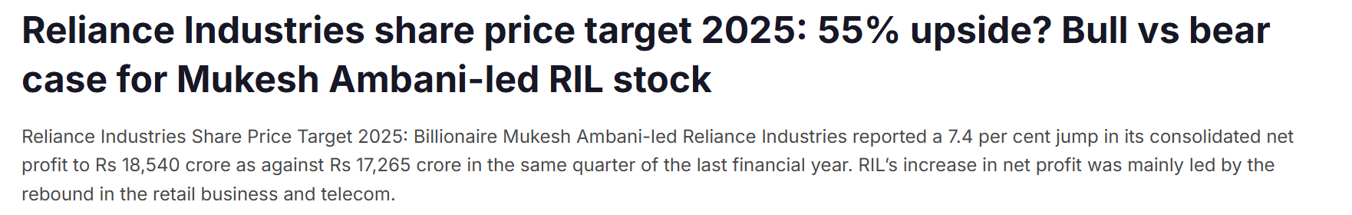
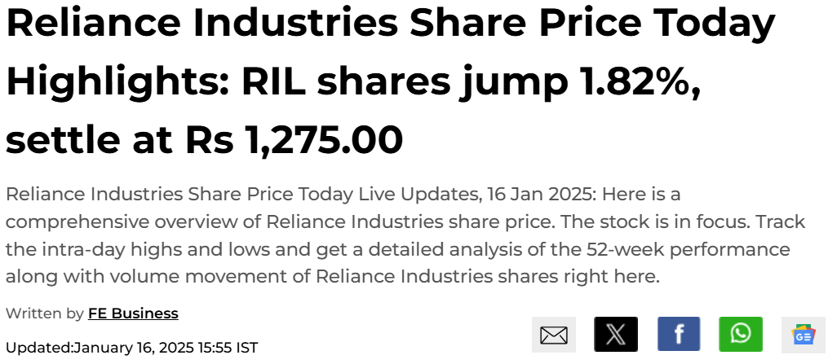
Reliance Industries Limited
Source : ET Now January 28, 2025
Source : Financial Times, January 16, 2025
Notes:
In the first quarter of 2025, Reliance Industries has demonstrated exceptional resilience and growth, positioning itself as a leader in the market. Here’s why investing in Reliance is a compelling opportunity:
Robust Financial Performance: In January, Reliance reported a remarkable 12% increase in consolidated net profit, reaching an all-time high of ₹21,930 crore. With revenues climbing to ₹267,186 crore, this growth underscores the company’s strong operational efficiency and profitability.
Strategic Stock Positioning: Despite recent fluctuations, the stock presents a unique opportunity for savvy investors. Following the earnings report, Reliance’s stock offers potential for recovery and growth as market conditions stabilize.
Bold Investments in Assam: In February, Mukesh Ambani announced a transformative ₹50,000 crore investment in Assam over the next five years. This strategic move focuses on enhancing technology readiness, green energy initiatives, and expanding retail operations, positioning Reliance as a pivotal player in regional development.

Slide 3
Overview
Abstract
01
Introduction
02
research Questions
03
Literature Review
04
Data Analysis
05
Implementation
06
Phase 01
07
Phase 02
08
Results Discussions
09
Recommendations
10
Limitations & Future Directions
11

Slide 4

01
Trading patterns of Reliance Industries Limited on Bombay Stock Exchange and London Stock Exchange.
Abstract
02
10-minute midpoint returns over January-February 2025.
03
Cross-border trading dynamics and its effects on liquidity and price discovery.
The data pipeline includes mapping metrics to session-overlap windows, aligning price series on a UTC grid, considering market microstructure, and developing risk metrics.
04
05
Results : significant tail-risk clustering during overlapping trading hours of BSE and LSE.
06
Highlights the need for real-time price and liquidity adjustments in Reliance's trading behavior.
Notes:
The study analyzes trading patterns of Reliance Industries Limited (RIL) on the Bombay Stock Exchange (BSE) and London Stock Exchange (LSE) by examining 10-minute midpoint returns over a two-month period (January-February 2025). The goal is to understand cross-border trading dynamics and their impact on liquidity and price discovery. The methodology includes mapping metrics onto session-overlap windows, aligning price series on a UTC 10-minute grid, considering market microstructure, and developing risk metrics. Results indicate significant tail-risk clustering during overlapping trading hours, emphasizing the need for real-time adjustments to price and liquidity in RIL's trading behavior.

Slide 5
Introduction
Overview
Why Reliance Industries?
24/5 trading reshapes global markets, extends price discovery.
Reliance Industries Limited (RIL) faces opportunities and challenges with BSE and LSE trading hours. Investors gain instant liquidity and real-time price signals.
High-frequency volatility necessitates robust sub-hour risk management.
Reliance Industries Limited makes an ideal prototype for developing and testing intraday risk metrics.
By focusing on a single firm, we can isolate the impact of corporate specific news, that is, broader market noise.
Moreover, RIL’s cross-listings on BSE and LSE allows us to compare how extended trading hours and microstructural differences across rising markets influence high-frequency volatility and price dynamics.
Notes:
Emphasize the significance of 24/5 trading in reshaping global markets.
Highlight the role of Reliance Industries Limited (RIL) in navigating the complexities of the stock market, particularly in relation to BSE and NSE trading.
Why Reliance Industries?:
Market Leadership: RIL is positioned as a significant player in the trading landscape, addressing investor challenges on major exchanges.
Focus on Strategy: By enhancing intraday risk management, RIL aims to improve trading efficiency and investor confidence.
High-Frequency Trading: Discuss how RIL’s robust infrastructure supports high-frequency trading, providing a competitive edge in market responsiveness.

Slide 6
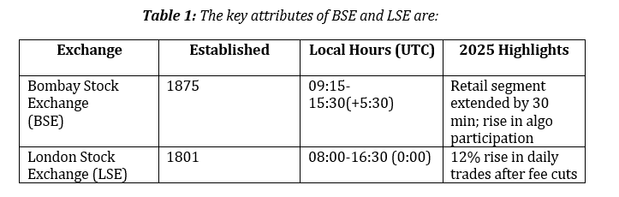
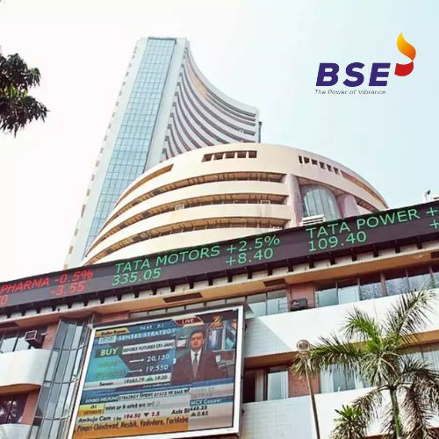
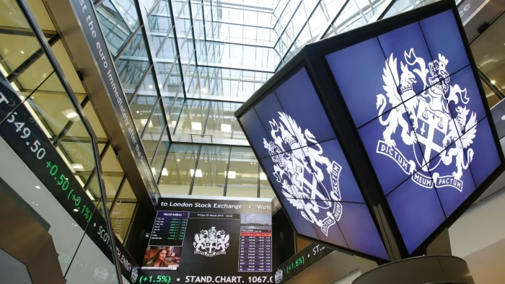
Bombay Stock Exchange and London Stock Exchange
Notes:
Let's take a closer look at the key attributes of two major stock exchanges: the Bombay Stock Exchange (BSE) and the London Stock Exchange (LSE).
Exchange Established: The BSE was established in 1875, making it one of the oldest stock exchanges in Asia. In contrast, the LSE was founded in 1801, highlighting its long-standing history in capital markets.
Local Trading Hours: The BSE operates from 9:15 AM to 3:30 PM IST, while the LSE runs from 8:00 AM to 4:30 PM UTC. This difference in hours reflects the global nature of trading and the need for flexibility in market participation.
Retail Participation: A noteworthy highlight is that retail participation in the BSE has increased by 30 million, showcasing a growing interest among individual investors. Additionally, the LSE has experienced similar trends, especially after recent tax cuts aimed at stimulating trading activity.
Understanding these attributes provides insight into how each exchange operates and their roles in facilitating market liquidity.

Slide 7
Question 1
How did transitioning towards continuous/automatic trading hours impact intraday volatility and price movements of Reliance Industries (RIL) stock across BSE and LSE?
Research Questions
Question 2
Can rolling 10- minute Value at Risk (VaR) spikes serve as early warning signals of emerging tail-risk clusters? And how do they align major corporate announcements and macroeconomic news releases?
Notes:
oving on to our research questions, which are pivotal for our study on trading dynamics.
Question 1: How did transitioning towards continuous/automatic trading hours impact intraday volatility and price movements of Reliance Industries (RIL) stock across BSE and LSE?
This question aims to explore the effects of automated trading systems on market behavior, particularly focusing on how these systems influence stock volatility and price fluctuations.
Question 2: Can rolling 10-minute Value at Risk (VaR) spikes serve as early warning signals of emerging tail-risk clusters? How do they align with major corporate announcements and macroeconomic news releases?
This question delves into risk management, examining how VaR can indicate potential risks in the market and how these risks correlate with significant news events.
These questions guide our investigation into the interplay between trading mechanisms and stock performance.

Slide 8
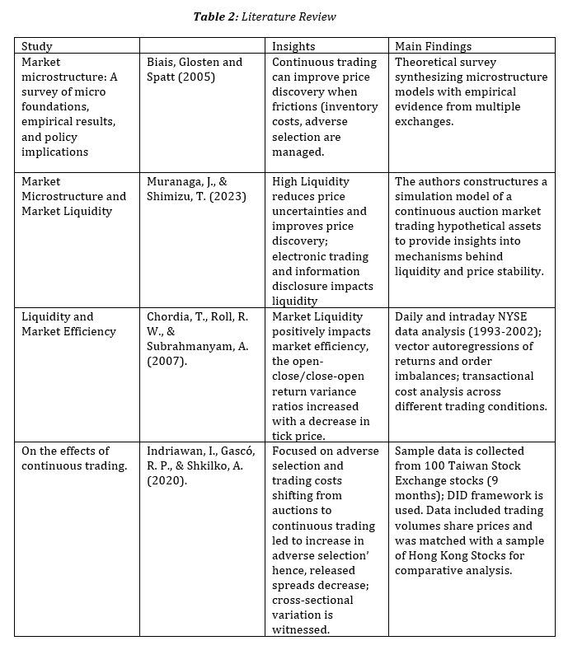
Literature Review
Notes:
Now, let’s discuss the literature review, which provides a foundation for our research.
Study Insights: We draw from various studies, including those by Bias, Glosten, and Spatt (2005), and Murugan, & S. S. (2023). These studies highlight the evolution of trading practices and their implications for market efficiency.
Main Findings:
The insights reveal that transitioning to continuous trading has led to improved liquidity and price discovery.
Additionally, the studies construct models that analyze how liquidity risks impact trading strategies, providing empirical evidence on this subject.
By synthesizing these findings, we can better understand the current landscape and position our research effectively within the existing body of knowledge.

Slide 9
Section | Details
Study Aim | Understand the valuable groundwork by documenting volatility measures and session comparisons.
Importance | Greater precision is required by risk managers and automated controllers due to continuous trading being entrenched.
Framework Refocus | 10-minute midpoint returns on BSE and LSE over a two-month sample January 28 – March 11, 2025 with two analyzing factors:
 | 1) Market Microstructure considerations
 | 2) Risk Metrics Developments
Timestamp and Data Alignment | All timestamps anchored to UTC and data aligned to a 10-minute grid.
Data Integrity Measures | Missing intervals (< 4 per day) forward-filled; days with excessive gaps dropped.
Resulting Panel | Approximately 6,900 observations per market, providing ample granularity to detect microstructural risk patterns.
Data Preparation and Feature Engineering | Intraday market data obtained from Bloomberg Terminal, including BSE and LSE sheets with time-stamped observations of Open, High, Low, Close prices, simple moving averages, and traded volume.
About the Dataset
Notes:
Let's discuss the dataset used for our analysis:
Study Aim: Our primary goal is to establish a solid foundation by documenting volatility measures and session comparisons.
Framework Refocus: We concentrated on two main aspects:
Market Microstructure considerations.
Risk Metrics development.
Data Alignment: All timestamps are converted to UTC to ensure consistency across datasets.
Data Integrity Measures: We accounted for missing values, which averaged around four per day, and addressed these gaps to maintain data quality.
Preparation and Feature Engineering: Data was obtained from Bloomberg Terminal, focusing on key metrics like open, high, low, close prices, and simple moving averages.

Slide 10
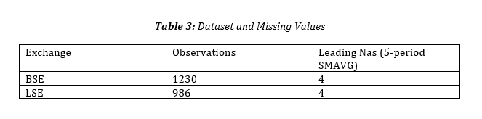
Step 1: Handling Missing Values
Data Analysis
Step 2: Analysis
Phase 01 : Market Microstructure Analysis
Phase 02: Risk Metrics Development
Notes:
Now, let’s look at the data analysis steps:
Step 1: Handling Missing Values: We identified and addressed missing data points in both BSE and LSE datasets, ensuring our analysis is robust.
Step 2: Analysis Phases:
Phase 1: Focuses on Market Microstructure, understanding how trading times and volumes interact.
Phase 2: Develops Risk Metrics, analyzing the volatility and risk factors associated with RIL’s stock.

Slide 11
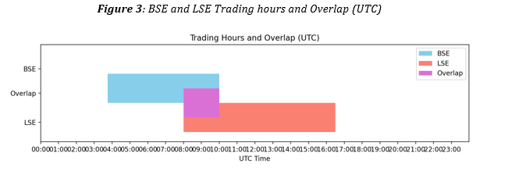

Phase 01 : Market Microstructure
BSE AND LSE Trading and Overlap (UTC)
·The LSE trading hours are from 08:00 UTC to 16:30 UTC.
·The BSE trading hours are from 03:45 UTC to 10:00 UTC.
·The overlapping hours (purple section) are when both the markets are open simultaneously (08:00-10:00).
Notes:
Slide 3: Phase 01: Market Microstructure
Speaker Notes:
In this phase, we examine the market microstructure, specifically the trading hours of BSE and LSE:
Trading Hours and Overlap:
The LSE operates from 08:00 to 16:30 UTC.
The BSE operates from 03:45 UTC to 10:00 UTC.
Overlap Period: The purple section highlights the overlapping trading hours from 08:00 to 10:00 UTC, which is critical for liquidity and market dynamics.
Understanding these trading hours helps us analyze market behavior effectively.

Slide 12
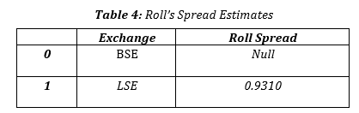
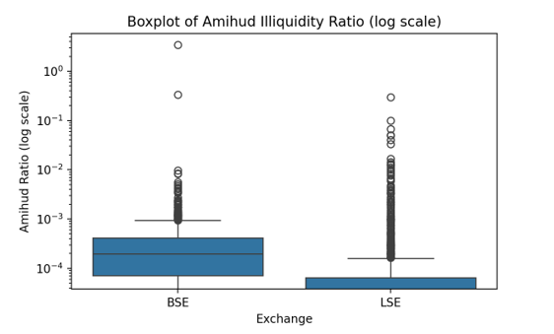
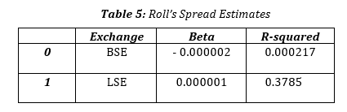
Phase 01 : Market Microstructure
Order Book dynamics (Roll’s spread estimates)
3. Amihud Illiquidity Ration Boxplot
2. Trade Impact Analysis
Notes:
In this phase, we analyze key aspects of market microstructure relevant to RIL and its investors:
Order Book Dynamics:
The table presents Roll's spread estimates for both BSE and LSE.
The Roll Spread for BSE is 0.0000, indicating very low transaction costs, while LSE shows a higher spread of 0.9310. This suggests that trading RIL shares on the BSE is more cost-effective for investors.
Trade Impact Analysis:
The analysis provides insights into market behavior through regression metrics.
The Beta values and R-squared statistics help us understand the relationship between RIL's stock movements and broader market trends.
A lower R-squared value indicates less correlation with market movements, suggesting RIL may have unique trading characteristics.
Amihud Illiquidity Ratio Boxplot:
The boxplot visualizes the Amihud Illiquidity Ratio, which measures price impact per unit of volume.
The higher ratio for LSE indicates greater price volatility associated with trading volume, while BSE shows more stability.
Implications for RIL and Traders:
Cost Efficiency: The lower Roll spread on BSE makes it a more attractive venue for trading RIL, minimizing transaction costs for investors.
Market Stability: With a lower Amihud Illiquidity Ratio on BSE, traders can expect less price impact from their trades, suggesting a more stable trading environment for RIL shares.
Strategic Trading: Understanding these microstructure dynamics allows traders to make informed decisions about where to invest in RIL, potentially leading to better returns and lower risks.

Slide 13
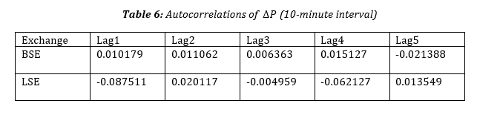
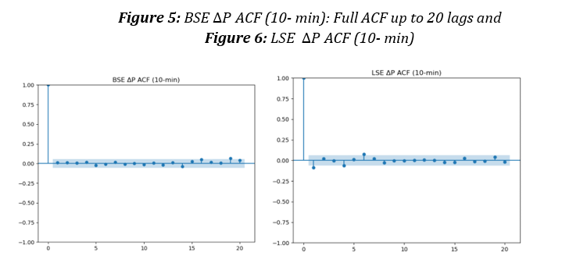
Phase 01 : Market Microstructure
4. Spread Autocovariance Analysis
Notes:
we have delved into the comparison of depth and price-impact metrics between the BSE and LSE using trade-impact regressions and Amihud illiquidity ratios. Now, let's explore the dynamics of bid-ask bounce and investigate microstructure noise in these markets.
To do this, we analyzed the change in price, ∆P_t, calculated from closing prices at ten-minute intervals. We then examined the autocorrelation of these changes at lags 1 through 5, as shown in Table 6.
For BSE, the autocorrelation results indicate that the rapid bid-ask reversals cancel each other out, leaving no detectable “bounce” in our sampled returns. This means that the alternating trades hit the bid and then the ask, effectively washing out the implicit spread. To further observe microstructure effects in BSE, we would need tick-by-tick transaction data and direct order-book quotes.
In contrast, the LSE shows a negative autocorrelation at lag 1, suggesting different dynamics at play.
Speaker Notes:
In this section, we analyze the spread and autocovariance of price changes (ΔP) for RIL.
Order Book Dynamics: The table presents Roll's spread estimates for BSE and LSE.
Implication for Traders: The lower Roll spread on BSE (0.0000) indicates reduced transaction costs, making it cheaper for traders to buy and sell RIL shares. This cost efficiency can attract more retail and institutional investors to trade on BSE.
Autocorrelations: The autocorrelation values at various lags suggest how past price movements may influence future prices.
For RIL: A significant autocorrelation on BSE suggests that price trends may persist, which can be advantageous for traders using momentum strategies. Understanding these dynamics allows traders to make informed decisions about entry and exit points.

Slide 14
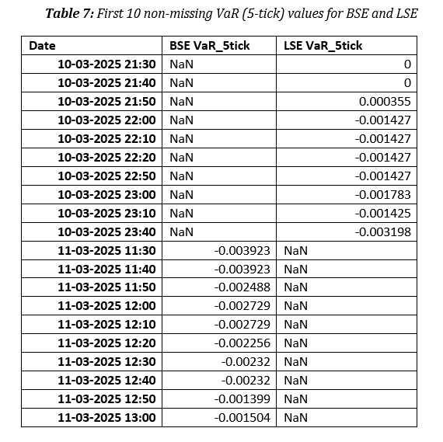

Phase 02 : RisK Metric Development
Intradaay VaR (5 Stick Rolling 95% VaR)
Question:
“Over the next five such intervals (50 minutes), what would be the worst loss one can expect, 95% of the time?”
Notes:
Now, we transition to risk metrics development, focusing on Intraday VaR (Value at Risk).
VaR Calculation: The question posed examines the worst possible loss over 50-minute intervals, using the 5th percentile of returns.
Relevance for RIL: This metric helps quantify the potential downside risk for RIL shares, allowing investors to assess their risk exposure effectively.
Implications for Traders: By understanding potential losses, traders can better manage their portfolios and set appropriate stop-loss orders, enhancing their risk management strategies. This insight is crucial during volatile market conditions, where RIL's stock may experience significant fluctuations.

Slide 15
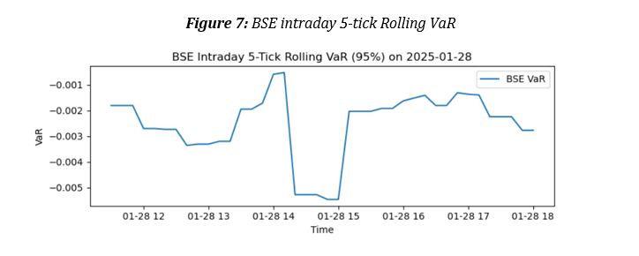
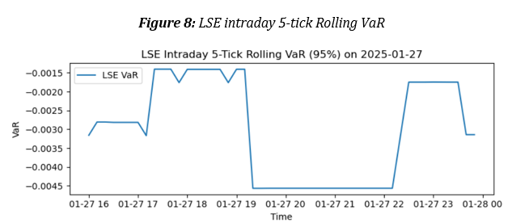
Phase 02 : RisK Metric Development
Intradaay VaR (5 Stick Rolling 95% VaR)
Tail-Risk
Notes:
Ladies and gentlemen,
Let's look at the VaR profiles of the LSE and BSE exchanges. They both show a U-shaped pattern throughout the trading day.
First, right after the market opens, we see a sharp spike downward in VaR, indicating intense information flow and price discovery. The LSE dips below -0.25%, while the BSE hovers closer to -0.20%.
Midday, trading slows down, bringing VaR back toward zero. However, the LSE remains more negative, indicating higher microstructure noise compared to the BSE.
As the market approaches closing, there's another uptick in activity, driven by auction imbalances and position adjustments. The LSE shows more pronounced spikes, suggesting tighter spreads and higher order-flow dynamics.
In summary, the BSE exhibits 20-30% less short-term tail risk than the LSE at the 10-minute frequency.
Why does this matter?
Real-Time Risk Limits: Traders can use VaR to adjust exposure and limit potential losses before they escalate.
Microstructure Dynamics: Monitoring VaR differences helps diagnose liquidity and trading frictions.
Strategy Timings: With this U-shaped risk profile, algorithmic executions might avoid open and close windows or allocate liquidity differently.
This slide presents the Intraday VaR findings for both BSE and LSE.
Graph Analysis: The graphs show the rolling VaR for both exchanges over time.
For RIL Investors: Spikes in VaR indicate periods of heightened risk, which are critical for decision-making. Traders should be particularly cautious during these periods as they may signal increased volatility in RIL's stock price.
Strategic Implications: Understanding these risk patterns helps investors time their trades more effectively, avoiding trading during high-risk periods or adjusting their positions accordingly.

Slide 16
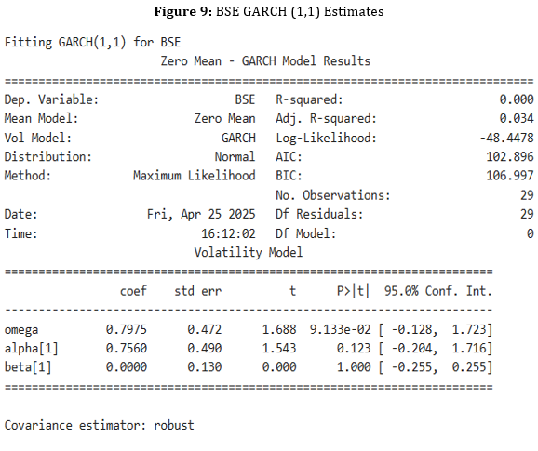
Phase 02 : RisK Metric Development
Time -Varying volatility modelling with GARCH
Notes:
In the analysis of Reliance Industrie’s cross-listed returns, it is observed that there is clear evidence of time-varying volatility. This means that there are periods of heightened turbulence tend to cluster together. This makes a GARCH framework both appropriate and informative. So, I do this by fitting a standard GARCH (1,1) model with zero mean to the daily log-returns (%) of the BSE and LSE listings. The following parameters are estimated: As seen from Figure 9, the fitted GARCH (1,1) model yields an ω of 0.7975, α₁ of 0.7560, and β₁ of zero.
What does this tell us? It suggests that rather than volatility clusters driven by persistent multi-day variances, they are driven by one-day shocks entirely.
Here, we focus on the GARCH model results for BSE, which estimates volatility over time.
Model Output: The coefficients derived from the GARCH model indicate how past volatility influences current volatility.
Relevance to RIL: Knowing the volatility dynamics allows traders to anticipate potential price swings in RIL's stock, helping them to adjust their risk exposure proactively.
For Traders: This information is vital for options trading and other derivatives strategies, as it helps in pricing and managing positions effectively based on expected future volatility.

Slide 17
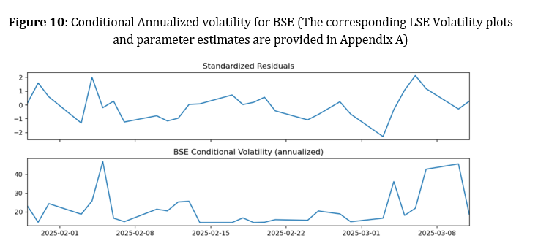
Phase 02 : RisK Metric Development
Time -Varying volatility modelling with GARCH
Notes:
In Figure 10, I have tried to plot the annualized conditional volatility for Reliance’s BSE listing over the sample period. It can be noticed that there are sharp spikes on dates corresponding to major price moves. This can be noticed during the two-hour London-Mumbai overlap window
Finally, we examine the conditional annualized volatility for BSE.
Volatility Patterns: The graph illustrates fluctuations in volatility over time, providing insights into RIL's market behavior.
Implications for RIL: Understanding these patterns can help investors make informed decisions about when to enter or exit positions based on expected market conditions.
For Traders: Recognizing periods of high volatility allows traders to adapt their strategies, whether that means increasing leverage during stable periods or being more conservative during volatile times. This adaptability is crucial for maximizing returns while minimizing risk.

Slide 18
Results & Discussion
01
02
03
Tail Risk Spikes
Behavior on BSE & LSE Markets
Risk Profile - RIL
Tail-risk spikes for Reliance Industries Limited (RIL) occur during overlapping hours of the Bombay Stock Exchange (BSE) and London Stock Exchange (LSE), causing extreme price movements.
RIL's trading on BSE shows more illiquidity spikes, while LSE remains stable for large orders. BSE has higher liquidity premiums due to price swings.
RIL's U-shaped risk profile suggests avoiding market openings and closings for better volatility management. Algorithmic trading can help by avoiding these periods.
Notes:
Tail Risk Spikes:
RIL experiences tail-risk spikes during overlapping trading hours on BSE and LSE.
Implication: Traders should monitor these spikes to anticipate extreme price movements and adjust strategies.
Behavior on BSE & LSE:
More illiquidity spikes on BSE; LSE offers higher liquidity premiums.
For Traders: Consider executing trades on LSE during stable conditions for better transaction costs.
Risk Profile - RIL:
RIL's U-shaped risk profile indicates varying exposure to market conditions.
Relevance: This understanding helps traders optimize portfolio balance based on market expectations.

Slide 19
Recommendations
01
02
03
Dynamic Order-Execution Strategies
Tail- Risk Aware Position Sizing
Cross-Market Hedging and Netting
During overlapping hours (08:00–10:00 UTC), split large orders into smaller slices to mitigate sporadic illiquidity spikes on BSE.
Use liquidity-weighted algorithms (e.g., VWAP or TWAP) on LSE where depth is more stable.
• Adopt intraday U-shaped risk profiles—scale down position sizes at open and close on LSE when VaR peaks.
• Incorporate real-time GARCH-based volatility signals into risk limits to guard against single‐day shocks.
• Implement cross‐listed netting strategies: offset exposures on LSE when BSE liquidity dries up.
• Use bilateral hedges only when bid‐ask spread estimates (Roll’s method) on both exchanges remain within predefined thresholds.
Notes:
Dynamic Order-Execution Strategies:
Split large orders during overlapping hours (08:00-10:00 UTC) to mitigate liquidity spikes.
For RIL Investors: Enhances trade execution and reduces market impact.
Tail-Risk Aware Position Sizing:
Use U-shaped risk profiles to scale down positions during VaR peaks.
Implications: Better risk management to protect against sudden market shifts.
Cross-Market Hedging:
Implement netting strategies on LSE during BSE liquidity spikes.
For Traders: Helps manage risk effectively, especially in volatile periods.

Slide 20


Limitations & Future Directions
01
02
03
Expanded Time Frame and Assets
impact of Macro News and Event Risk
Machine-Learning–Driven Execution
Incorporate HFT yearly data or other cross-listed Indian equities (e.g., Infosys, TCS) to test robustness across market regimes.
Overlay macroeconomic announcements (e.g., RBI policy decisions) to quantify their contribution to intraday tail risks and microstructure shifts.
Develop reinforcement-learning algorithms that adapt order placement strategies dynamically based on real‐time liquidity and volatility forecasts.
Notes:
Expanded Time Frame and Assets:
Incorporate HFT data from other Indian stocks (e.g., Infosys, TCS) for broader insights.
For RIL: Enhances understanding of liquidity dynamics.
Impact of Macro News:
Analyze how macroeconomic events affect intraday risk and market structure.
Implications: Better timing of trades in response to news.
Machine Learning-Driven Execution:
Develop algorithms for real-time liquidity and volatility forecasts.
For RIL Investors: Improves trading efficiency and execution quality.

Slide 21
References
01
02
03
Biais, B., Glosten, L., & Spatt, C. (2005). Market microstructure: A survey of micro foundations, empirical results, and policy implications. Journal of Financial Markets, 8, 217–264. https://doi.org/10.1016/j.finmar.2004.11.001
Simulation model of a continuous‐auction market trading hypothetical assets to tease out the mechanisms behind liquidity and price stability.
Chordia, T., Roll, R., & Subrahmanyam, A. (2007). Liquidity and market efficiency. Journal of Financial Economics, 87(2), 249–268.
Daily and intraday NYSE data (1993–2002); vector autoregressions of returns and order imbalances; transaction‐cost analysis across different trading conditions.
Indriawan, I., Gascó, R. P., & Shkilko, A. (2020). On the effects of continuous trading. SSRN.

